Slide 1
ICE-5121: ADVANCE MACHINE LEARNING
Notes:
‹#›
Optimisation of the Beer Distribution Game

Slide 2
Decision Tree
‹#›
Decision Tree is a Supervised learning technique that can be used for classification problems.
It is called a decision tree because, similar to a tree, it starts with the root node, which expands on further branches and structure like as a tree.
In a Decision tree, there are two nodes, which are the Decision Node and Leaf Node.
Notes:
Optimisation of the Beer Distribution Game
‹#›

Slide 3
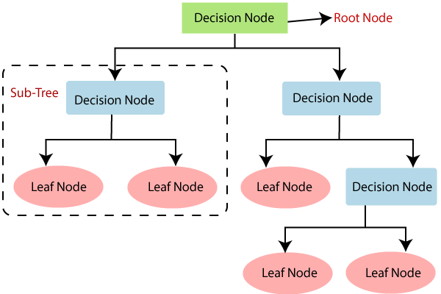
Decision Tree
‹#›
Fig. 1: Decision Tree
Notes:
Optimisation of the Beer Distribution Game
‹#›

Slide 4
Why use Decision Trees?
‹#›
Below are the three reasons for using the Decision tree:
Decision Trees usually mimic human thinking ability while making a decision, so it is easy to understand.
The logic behind the decision tree can be easily understood because it shows a tree-like structure.
It can handle both numerical and categorical data. It can also handle multi-output problems.
Notes:
Optimisation of the Beer Distribution Game
‹#›

Slide 5
Decision Tree Algorithms
‹#›
Iterative Dichotomiser 3 (ID3): This algorithm uses Information Gain to decide which attribute is to be used classify the current subset of the data. For each level of the tree, information gain is calculated for the remaining data recursively.
C4.5: This algorithm is the successor of the ID3 algorithm. This algorithm uses either Information gain or Gain ratio to decide upon the classifying attribute. It is a direct improvement from the ID3 algorithm as it can handle both continuous and missing attribute values.
Classification and Regression Tree (CART): It is a dynamic learning algorithm which can produce a regression tree as well as a classification tree depending upon the dependent variable.
Notes:
Optimisation of the Beer Distribution Game
‹#›

Slide 6
Steps in ID3 Algorithm
‹#›
It begins with the original dataset S.
On each iteration of the algorithm, it iterates through the every unused attribute of the dataset S and calculates Entropy (H) and Information gain (IG) of this attribute.
It then selects the attribute which has the smallest Entropy or Largest Information gain.
The dataset S is then split by the selected attribute (Root Node) to produce a subset of the data.
The algorithm continues to recur on each subset, considering only attributes never selected before.
Repeat until we run out of all attributes, or the decision tree has all leaf nodes.
Notes:
Optimisation of the Beer Distribution Game
‹#›

Slide 7
Attribute Selection Measures
‹#›
If the dataset consists of N attributes then deciding which attribute to place at the root or at different levels of the tree as internal nodes is a complicated step. By just randomly selecting any node to be the root can’t solve the issue.
For solving this attribute selection problem, researchers worked and devised some solutions. They suggested using some criteria like : (i) Entropy (ii) Information gain (iii) Gini Index
Notes:
Optimisation of the Beer Distribution Game
‹#›

Slide 8
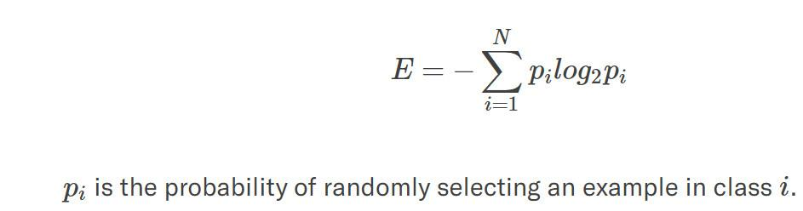
Entropy
‹#›
Entropy is a measure of the randomness in the information being processed. The higher the entropy, the harder it is to draw any conclusions from that information. Flipping a coin is an example of an action that provides information that is random.
Consider a dataset with N classes. The entropy may be calculated using the formula below:
Notes:
Optimisation of the Beer Distribution Game
‹#›

Slide 9
Information Gain
‹#›
We can define information gain as a measure of how much information a feature provides about a class. Information gain helps to determine the order of attributes in the nodes of a decision tree.
Information Gain = entropy(parent) – [average entropy(children)]
Notes:
Optimisation of the Beer Distribution Game
‹#›

Slide 10
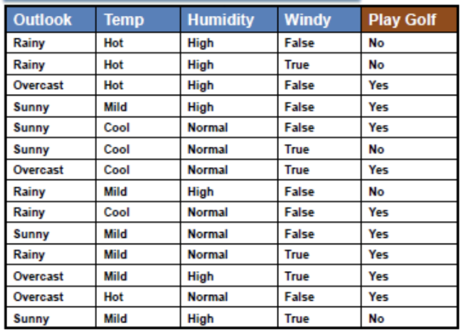
Dataset
‹#›
Notes:
Optimisation of the Beer Distribution Game
‹#›

Slide 11
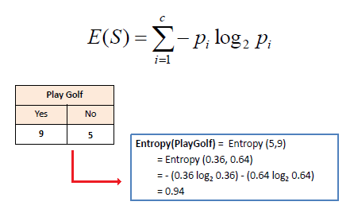
Entropy Calculation for One Attribute
‹#›
Mathematically Entropy for one attribute is represented as:
Notes:
Optimisation of the Beer Distribution Game
‹#›

Slide 12
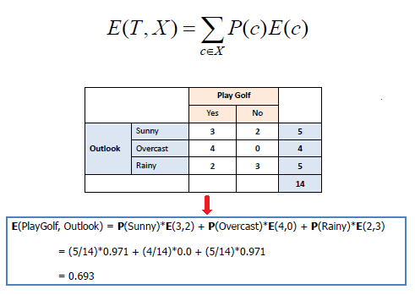
Entropy Calculation for Multiple Attribute
‹#›
Mathematically Entropy for multiple attributes is represented as:
Ireland
Virginia
Japan
California
H K/ Sing
Notes:
Optimisation of the Beer Distribution Game
‹#›

Slide 13
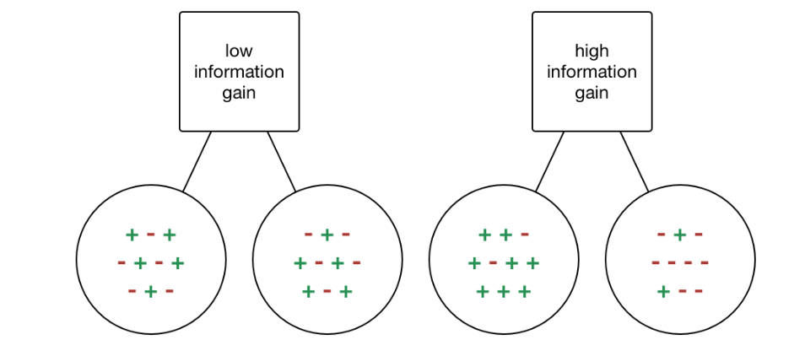
Information Gain (IG)
‹#›
We can define information gain as a measure of how much information a feature provides about a class. Information gain helps to determine the order of attributes in the nodes of a decision tree. Constructing a decision tree is all about finding an attribute that returns the highest information gain and the smallest entropy.
Ireland
Virginia
Japan
California
H K/ Sing
Notes:
Optimisation of the Beer Distribution Game
‹#›

Slide 14
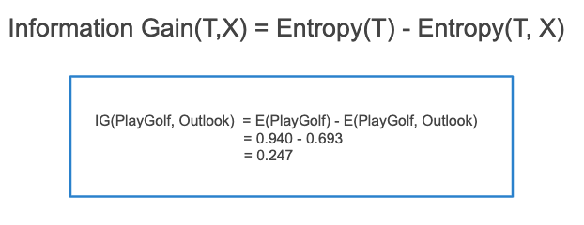
Information Gain Calculation
‹#›
Mathematically, IG is represented as:
Ireland
Virginia
Japan
California
H K/ Sing
Notes:
Optimisation of the Beer Distribution Game
‹#›

Slide 15
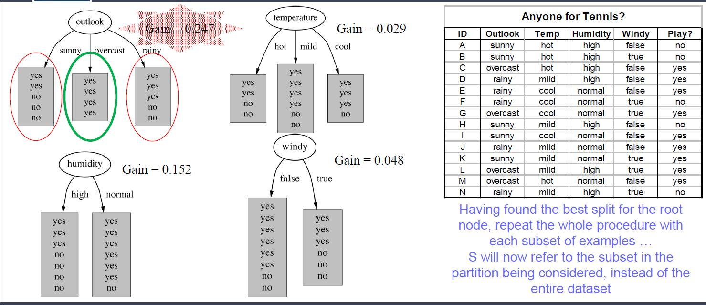
Drawing Decision Tree
‹#›
Ireland
Virginia
Japan
California
H K/ Sing
Notes:
Optimisation of the Beer Distribution Game
‹#›

Slide 16
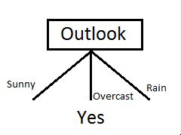
Drawing Decision Tree (cont.)
‹#›
Now select the feature having the largest Information gain. Here it is Outlook. So it forms the first node(root node) of our decision tree.
Ireland
Virginia
Japan
California
H K/ Sing
Notes:
Optimisation of the Beer Distribution Game
‹#›

Slide 17
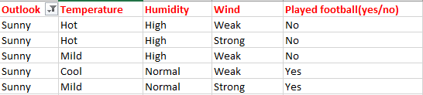
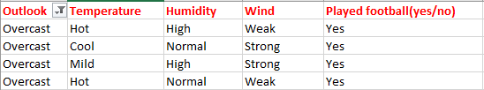
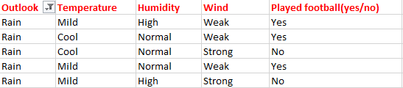
Drawing Decision Tree (cont.)
‹#›
Now our data look as follows :
Ireland
Virginia
Japan
California
H K/ Sing
Notes:
Optimisation of the Beer Distribution Game
‹#›

Slide 18
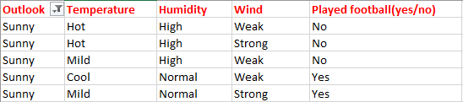
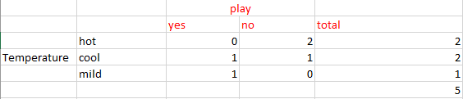
Drawing Decision Tree (cont.)
‹#›
Calculate parent entropy E(sunny)
E(sunny) = (-(3/5)log(3/5)-(2/5)log(2/5)) = 0.971.
Now Calculate the information gain of Temperature. IG(sunny, Temperature)
Ireland
Virginia
Japan
California
H K/ Sing
Notes:
Optimisation of the Beer Distribution Game
‹#›

Slide 19
Drawing Decision Tree (cont.)
‹#›
E(sunny, Temperature) = (2/5)*E(0,2) + (2/5)*E(1,1) + (1/5)*E(1,0)=2/5=0.4
Now calculate information gain.
IG(sunny, Temperature) = 0.971–0.4 =0.571
Similarly we get
IG(sunny, Humidity) = 0.971
IG(sunny, Windy) = 0.020
Here IG(sunny, Humidity) is the largest value. So Humidity is the node that comes under sunny. Similarly, find the nodes under rainy.
Ireland
Virginia
Japan
California
H K/ Sing
Notes:
Optimisation of the Beer Distribution Game
‹#›

Slide 20
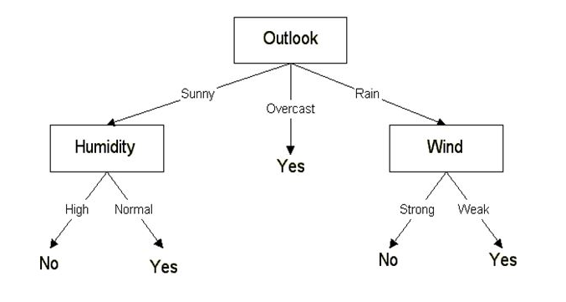
Drawing Decision Tree (cont.)
‹#›
Finally, our decision tree will look as below:
Ireland
Virginia
Japan
California
H K/ Sing
Notes:
Optimisation of the Beer Distribution Game
‹#›

Slide 21
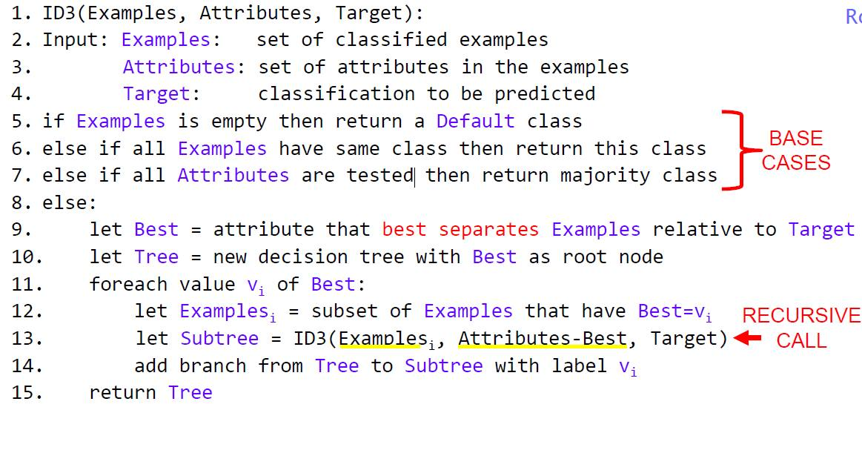
ID3 Algorithm
‹#›
Finally, our decision tree will look as below:
Ireland
Virginia
Japan
California
H K/ Sing
Notes:
Optimisation of the Beer Distribution Game
‹#›

Slide 22
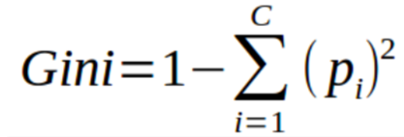
Home work
‹#›
Classification using CART algorithm: Classification using CART is similar to ID3. But instead of entropy, we use Gini index.
Ireland
Virginia
Japan
California
H K/ Sing
Notes:
Optimisation of the Beer Distribution Game
‹#›

